Slide 1
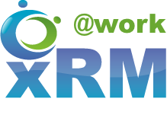
Creating your Personal Learning Plan
DYNAMICS 365

Slide 2

Mitch Milam
Dynamics CRM Architect
mitch@xrmcoaches.com
@mitchmilam
http://tinyurl.com/MitchMilamLinkedIn

Slide 3
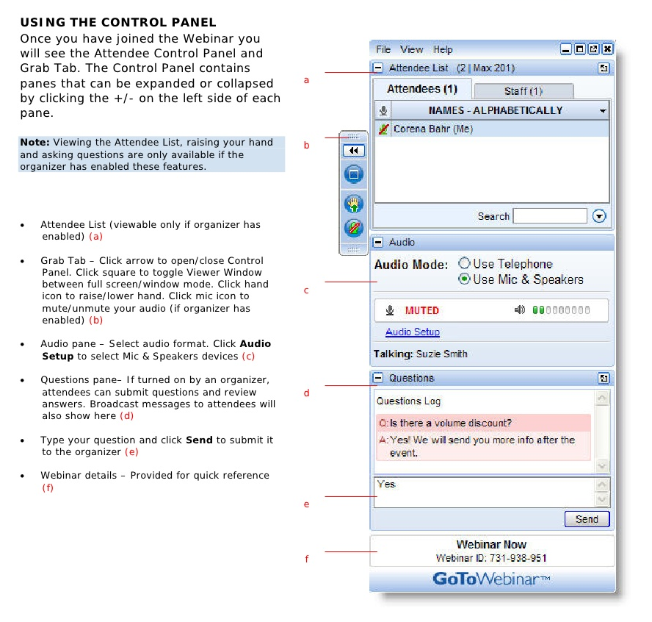
Webinar Housekeeping

Slide 4
Upcoming Events
Dynamics 365 Administration and Maintenance Workshop
Thursday, June 22nd
9:00am Central Time (US)

Slide 5
Getting Started

Slide 6
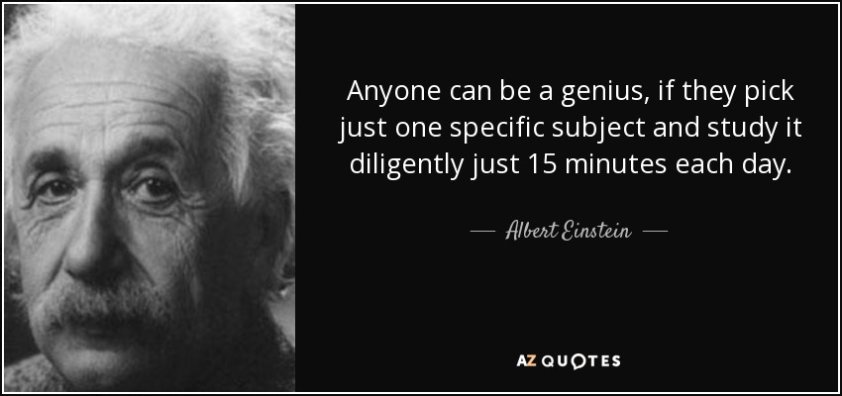

Slide 7
Stages of Knowledge
End-User
Power-User
Administrator
Customizer
Developer
Architect

Slide 8
End-User
Know how to utilize the product to accomplish a task (your job)

Slide 9
Power-User
Builds on the end-user skills
Knows and understands advanced features
Helps others
Understands the business and it’s processes
Can create automation (processes)

Slide 10
Administrator
Builds on the power-user skills
Adds day-to-day administration abilities
System maintenance
User maintenance
Troubleshooting
Automation

Slide 11
Customizer
Can build on administrator skills
Creates new components
Entities and Fields
Processes
Visualizations and dashboards
Etc.
Basic development skills using JavaScript

Slide 12
Developer
Builds on customizer skills
Fluent in the Dynamics 365 JavaScript object model
Can create plugins
Understands business processes and how to map them to Dynamics 365

Slide 13
Architect
Builds on all of the previous skillsets
Knows the product inside and out
Knows what features are generally best for any given requirement
Can translate business requirements into functional requirements
Can work with end-users and developers to define a solution

Slide 14
Education

Slide 15
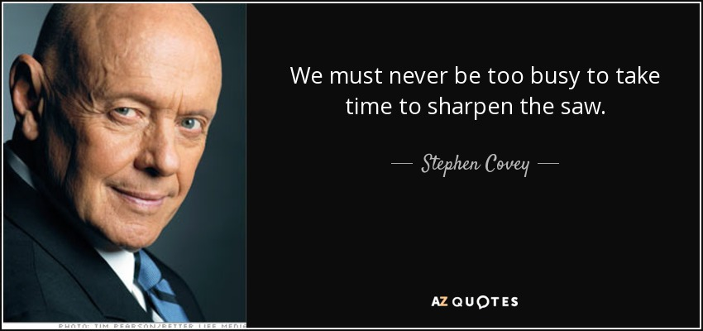

Slide 16
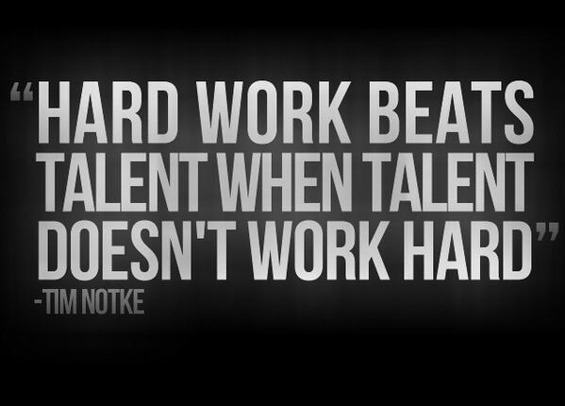

Slide 17
Resource Types
Websites and Blogs
YouTube
Books
Courses (on-demand, in-person)
Conferences (live and virtual)
User Groups

Slide 18
Useful Web Sites
Dynamics 365 User Group Blog Feed
https://www.crmug.com/browse/blogs
Microsoft Dynamics Communities
https://community.dynamics.com
CRM Tip of the Day
https://crmtipoftheday.com
http://youtube.com/crmtipoftheday

Slide 19
My Training Resources
Webinars
http://www.xrmcoaches.com/webinars
KnowledgeBits
http://www.xrmcoaches.com/knowledgebits
Learning Plans
http://www.xrmcoaches.com/freestuff
YouTube Channel
http://youtube.com/xrmcoaches

Slide 20
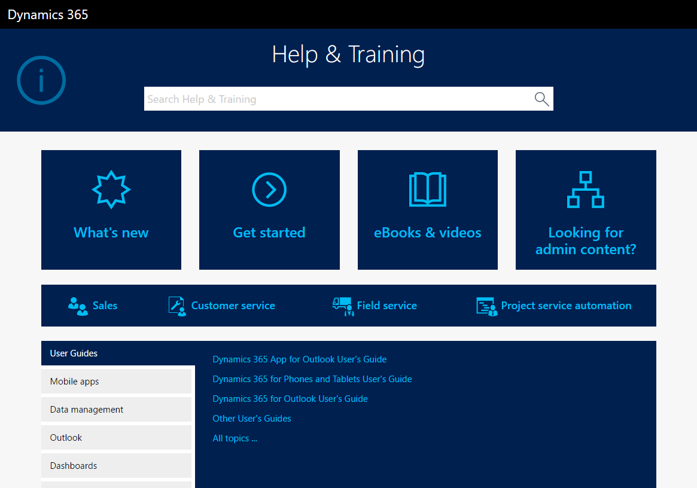
Help & Training

Slide 21
Certifications and Exams

Slide 22
Current Exam List
Exam Title | Exam Number
Microsoft Dynamics 365 customer engagement Online Deployment | MB2-715
Microsoft Dynamics 365 Customization and Configuration | MB2-716
Microsoft Dynamics 365 for Sales | MB2-717
Microsoft Dynamics 365 for Customer Service | MB2-718

Slide 23
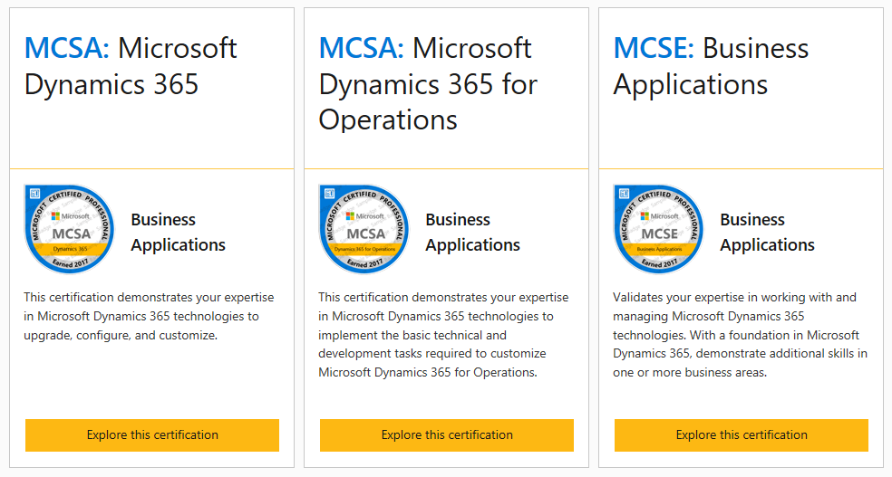
Certifications

Slide 24
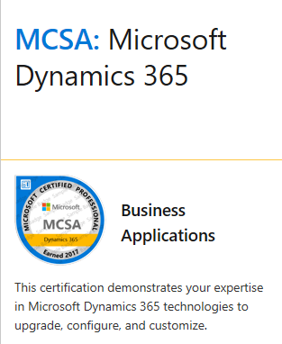
MCSA: Microsoft Dynamics 365
MB2-715
Microsoft Dynamics 365 customer engagement Online Deployment
MB2-716
Microsoft Dynamics 365 Customization and Configuration

Slide 25
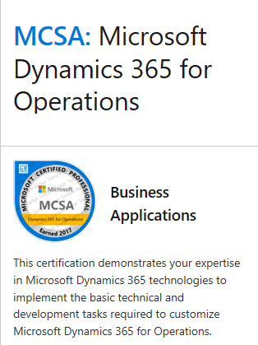
MCSA: Microsoft Dynamics 365 for Operations
70-764
Administering a Microsoft SQL Database Infrastructure
MB6-890
Microsoft Development AX Development Introduction

Slide 26
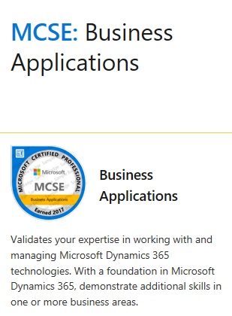
MCSA: Business Applications
MB2-717
Microsoft Dynamics 365 for Sales
MB2-718
Microsoft Dynamics 365 for Customer Service
MB6-892
Microsoft Dynamics AX – Distribution and Trade
MB6-893
Microsoft Dynamics AX – Financials

Slide 27
Defining Your Path

Slide 28
Define Your Goal
Certification
Product knowledge
New job or career
Just like being the smartest kid on the block

Slide 29
Functional Curve
Task
Application
Function

Slide 30








Microsoft Dynamics 365
Intelligent business applications in the cloud
Microsoft AppSource
Power BI
Sales
Project Service Automation
Customer Service
Microsoft Dynamics 365
Cortana Intelligence Suite
Field Service
+
Operations
Azure IoT Suite
Marketing
Common application platform: PowerApps, Microsoft Flow, Common Data Model
Notes:
What makes Dynamics 365 unique is that it harnesses the power of One Microsoft.
Deep integration between Dynamics 365 and Office 365 brings together the two worlds of business process and personal productivity. We surface familiar tools like Excel and Word within the context of business processes, significantly increasing productivity and decreasing context switching.
Power BI and Cortana Intelligence are natively embedded into Dynamics 365 business applications for predictive insights, prescriptive advice and actionable next steps. Additionally, Azure IoT brings device data to enable preemptive action in business functions like field service.
Businesses can also adapt and innovate in real-time with a common data model and an extensible business application platform, including PowerApps, Flow and Power BI Embedded.
We have also introduced Microsoft AppSource so business users to easily find and evaluate line of business SaaS applications from Microsoft and our partners, across Dynamics 365, Office 365, Cortana Intelligence and the Azure platform.
EXAMPLES TO ROMANCE ON THE VALUE OF DYNAMICS 365-
Data has become the new currency, and organizations create and have access to more of it, and faster than ever before. The challenge is how to transform it into intelligence that generates action and drive outcomes. Dynamics 365 will allow organizations to adopt individual business apps such as Marketing, Sales, Service and Operations, but as organizations adopt more of the apps, synergies will be unleashed in the form ‘Intelligent Business Processes’. This will help proactively guide employees & customers to generate optimal outcomes.
As an example – you can adopt Sales for Salesforce Automation, create quotes with standard prices and so on…. But if you have both the Sales and Operations Apps the pricing that will show up when you quote customers will consider tax rules, pricing & discount calculations from the Operations App, and it will automatically impact the inventory and manufacturing forecasts in the Operations App for more accurate and cost effective planning.
Another example could be derived from Project Service Automation. Project teams can use it as standalone app in close alignment with Office 365, but when combined with Operations, the time and expense reports that project members submit, will automatically go to account, HR and Payroll systems, and Project Accounts will be automatically updated for Finance in the Operations App.
It sounds basic… but the fact is that the classic delineation between CRM and ERP has created a separation in data and processes. Dynamics 365 breaks down this separation, and our business platform strategy together with CIT and IOT is centered on enabling this to new levels.

Slide 31
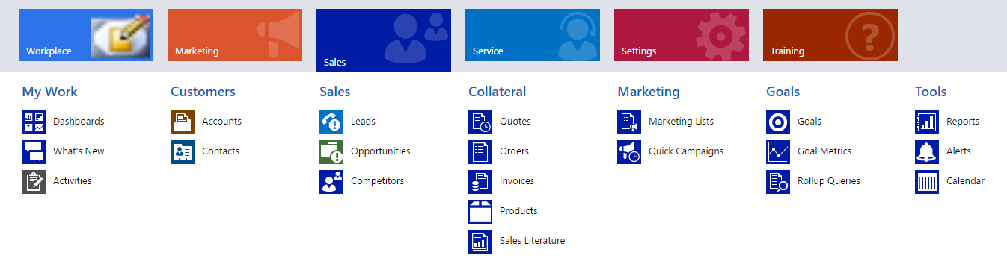
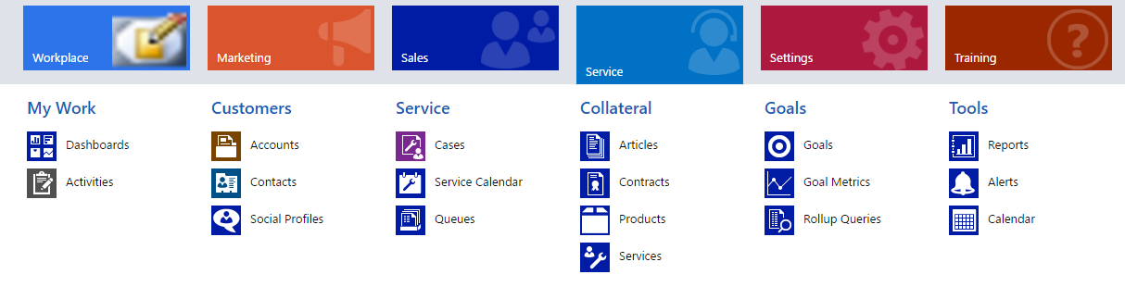
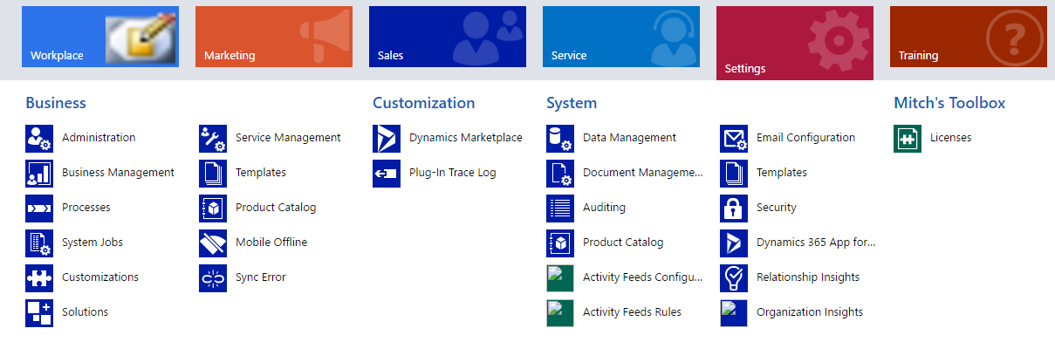
Learn By Function

Slide 32
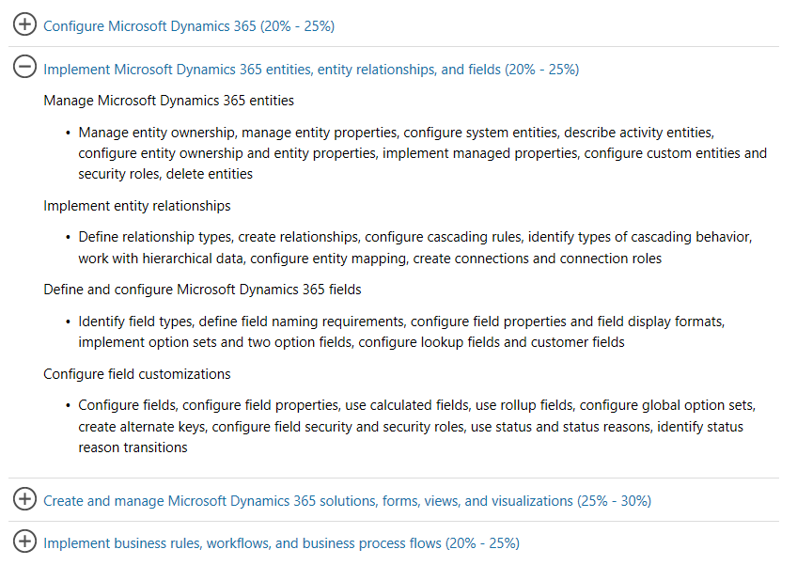
Certification as a Guide

Slide 33
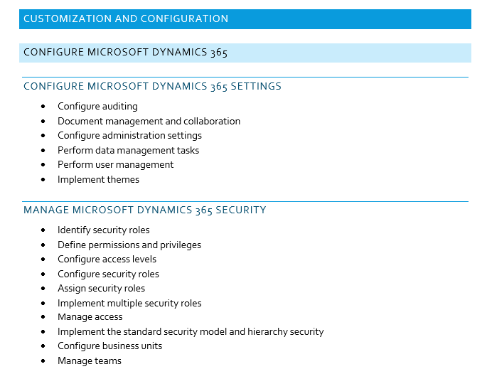
Sample Learning Plan

Slide 34
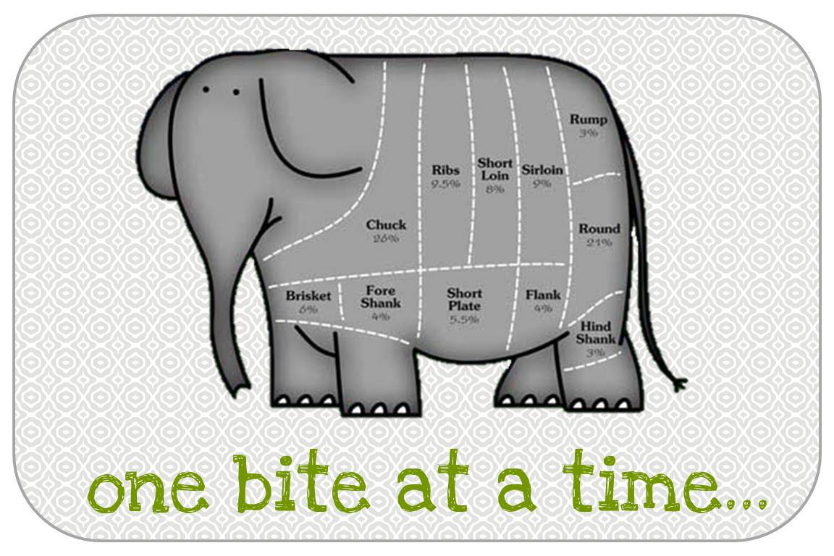
Don’t Forget…

Slide 35
Tips and Tricks
Track and review your progress frequently
Start with functional areas you already know
Be consistent (block out time on your calendar)
Certification exams are a great way to test your knowledge (with a side-effect of getting a certification)

Slide 36
Learning, in a Nutshell
Know
Comprehend
Understand
Teach

Slide 37
Deliberate Practice

Slide 38
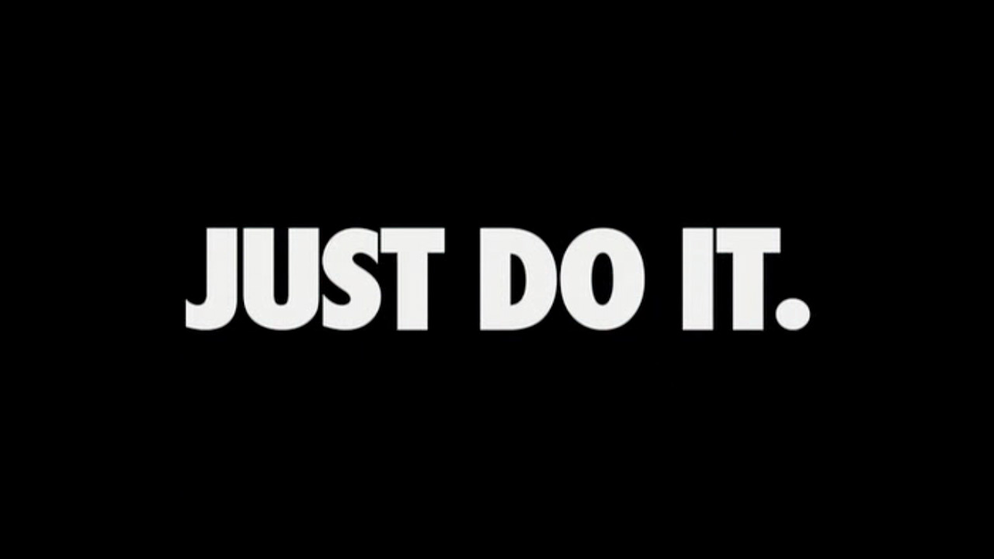

Slide 39
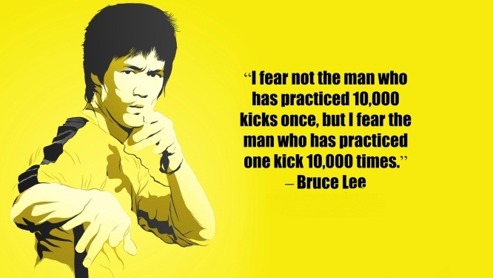

Slide 40
Test Environment
Create a virtual machine and configure Dynamics 365
Sign up for a trial for Dynamics 365 Online
* Remember that some features are only available online

Slide 41
Questions?

Slide 42
Thank You

